Slide 1
Intro to CUDA
Agenda
Architecture of CPU vs GPU
Write our first cuda program in c
Thread hierarchy And Warps
Divergence In Warps
SIMD VS SIMT
Links -
Github Pages -> https://ozzyozbourne.github.io/gpumode/
Github -> https://github.com/ozzyozbourne/gpumode

Slide 2
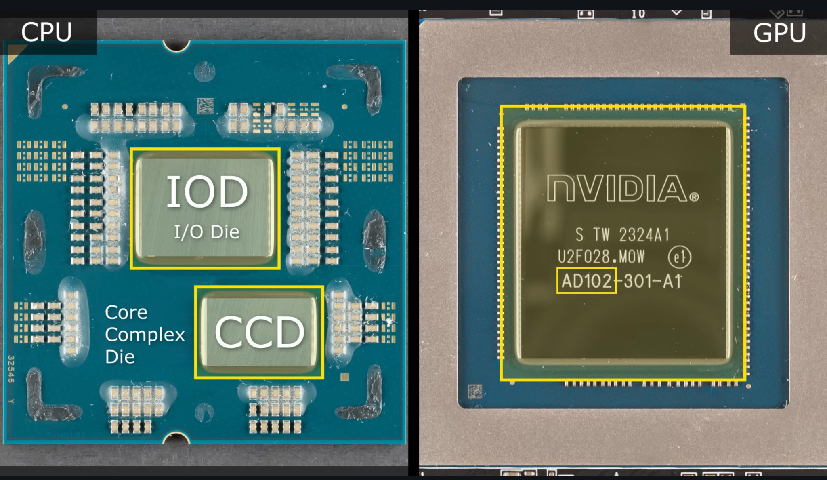

Slide 3
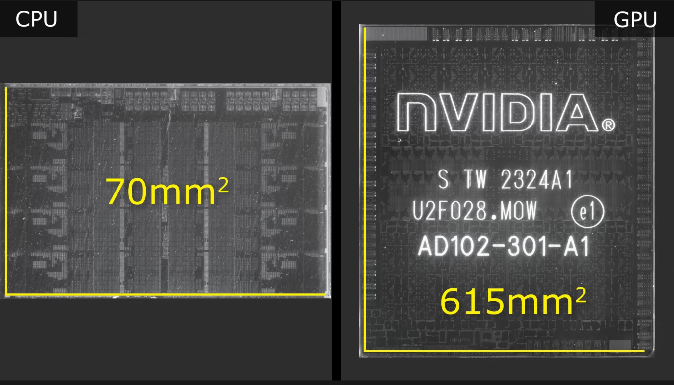

Slide 4
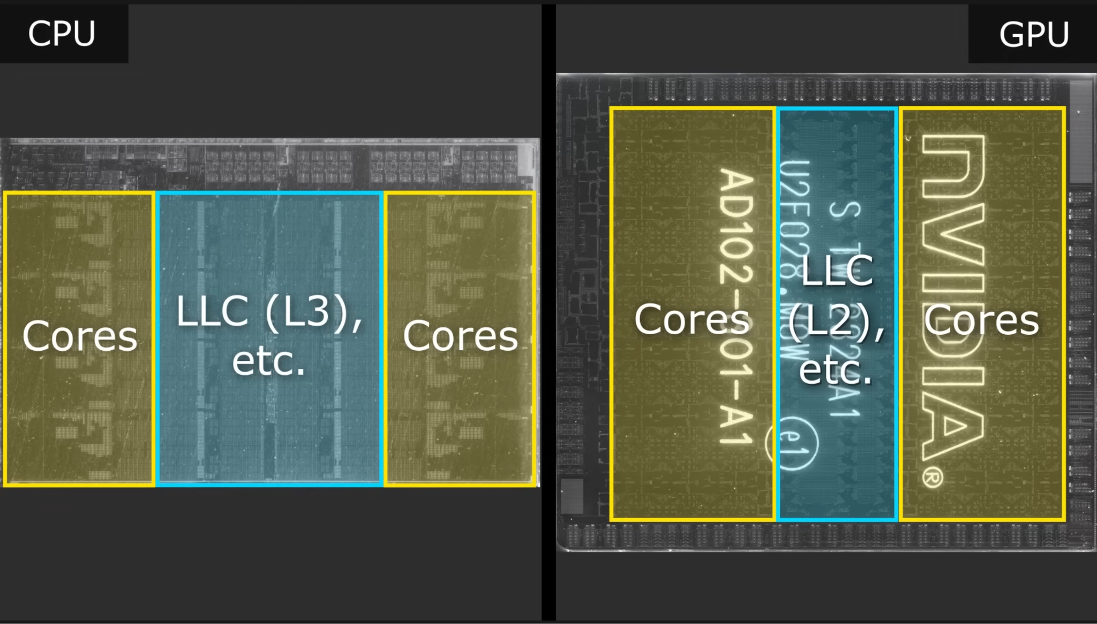

Slide 5
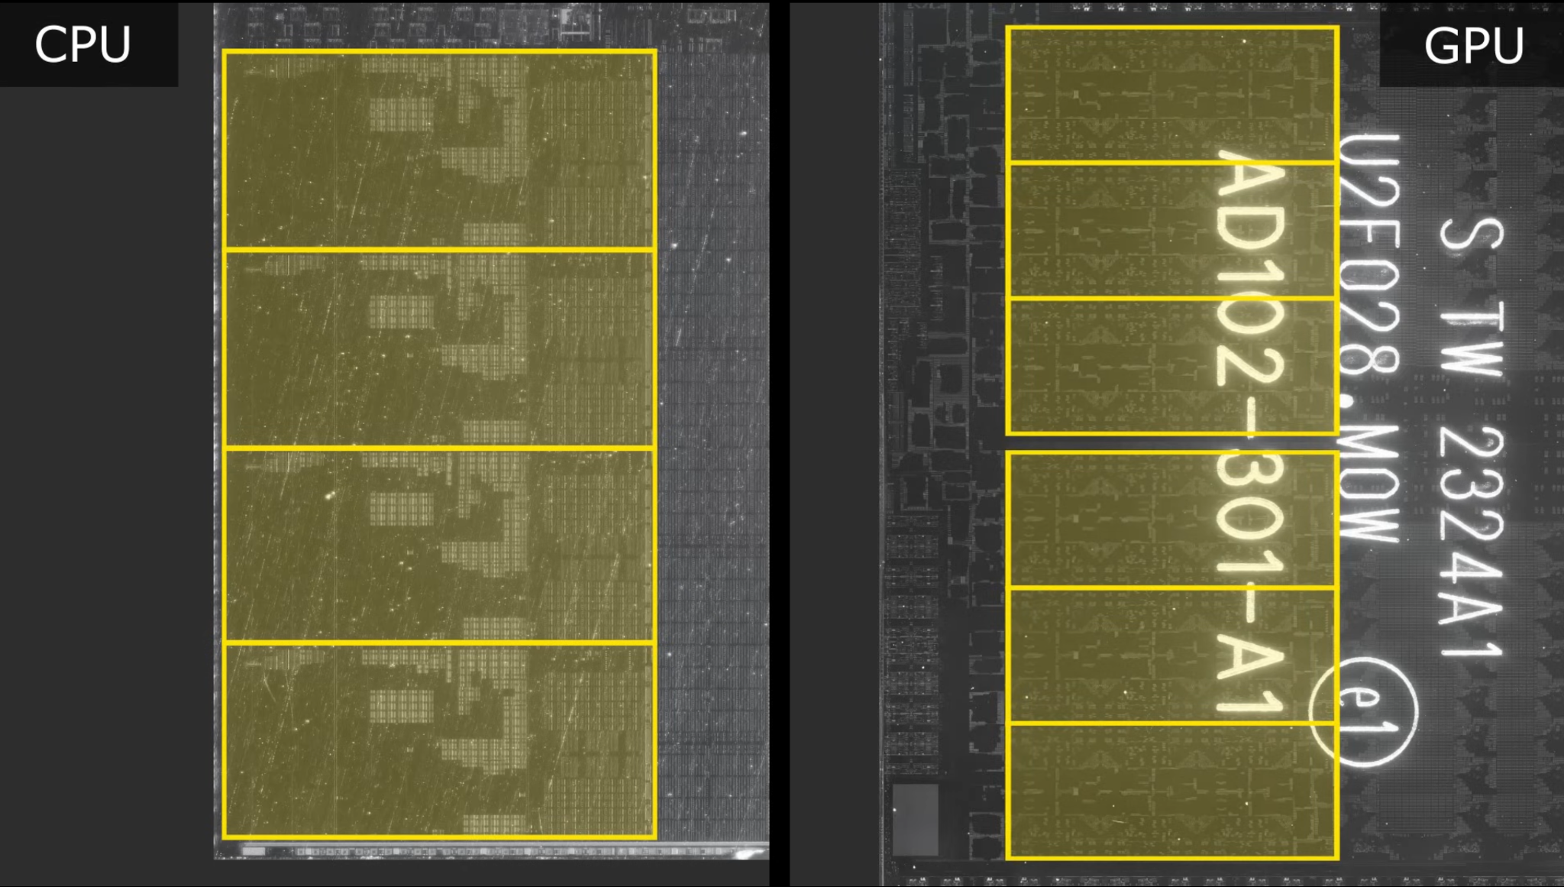

Slide 6
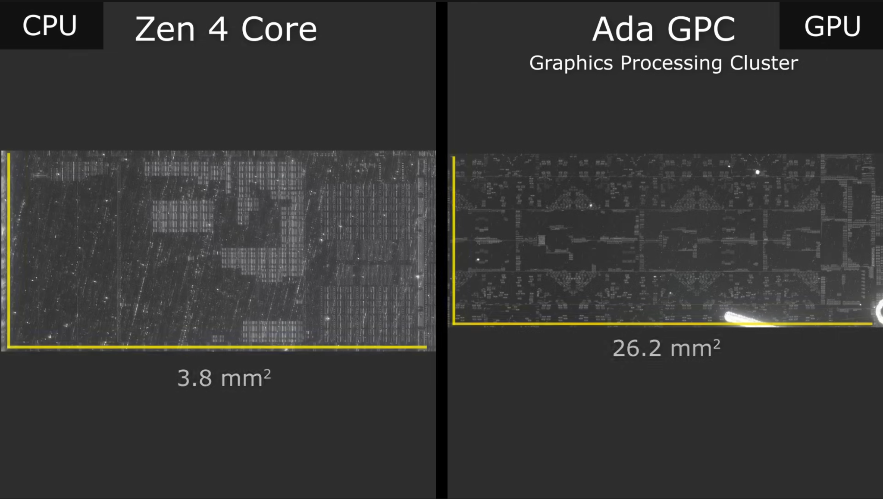

Slide 7
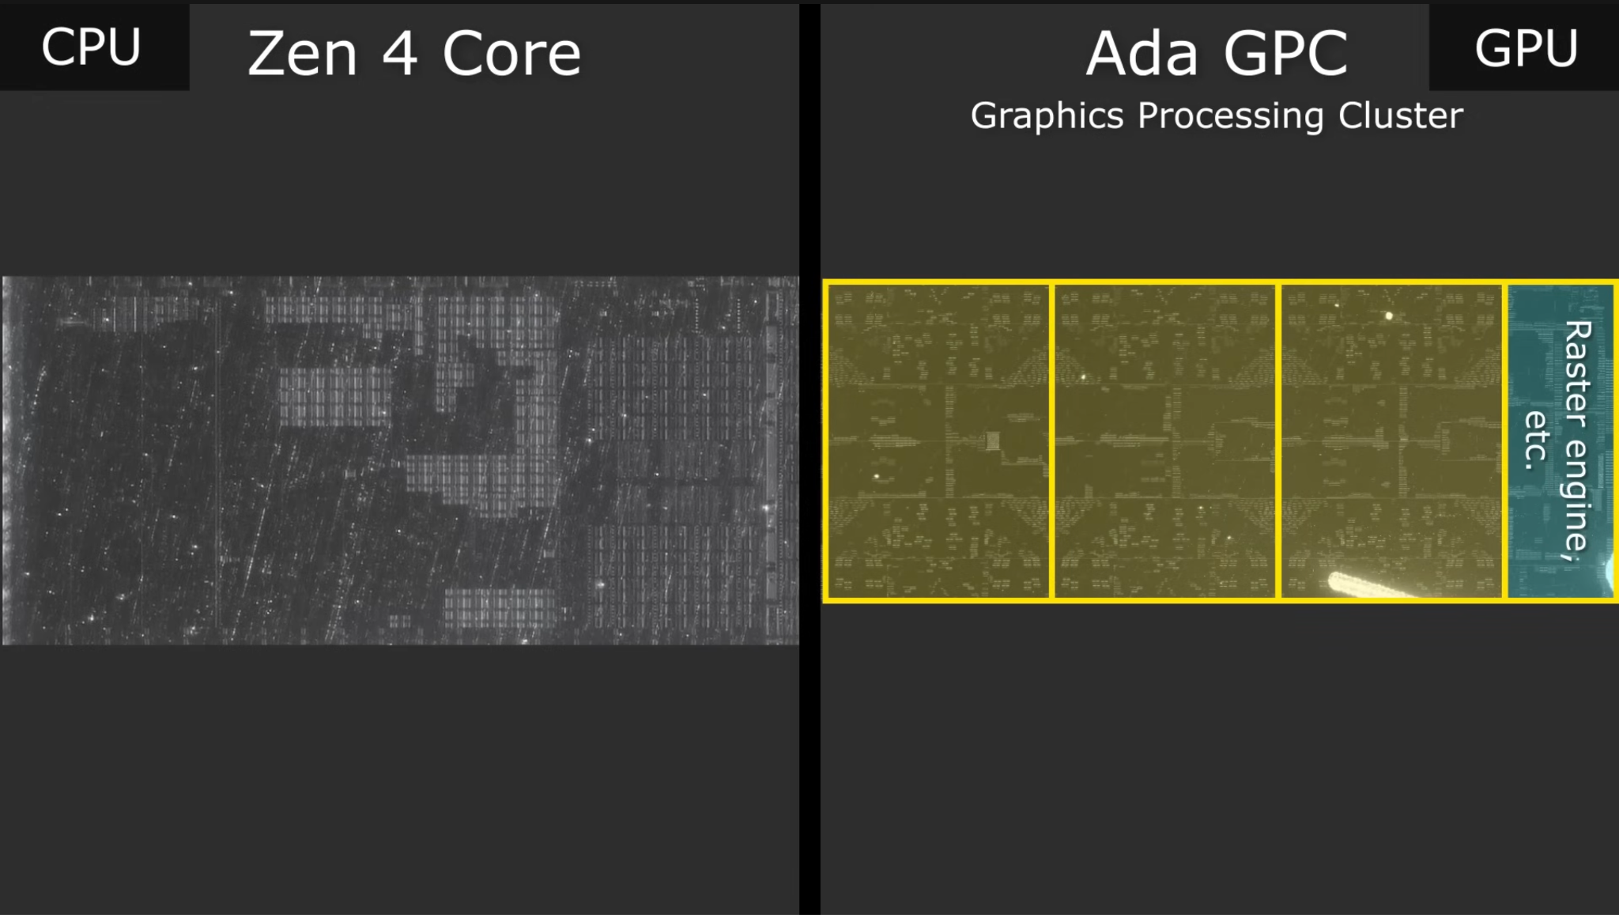

Slide 8
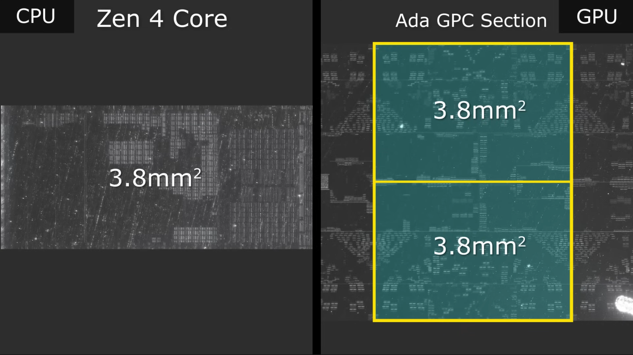

Slide 9
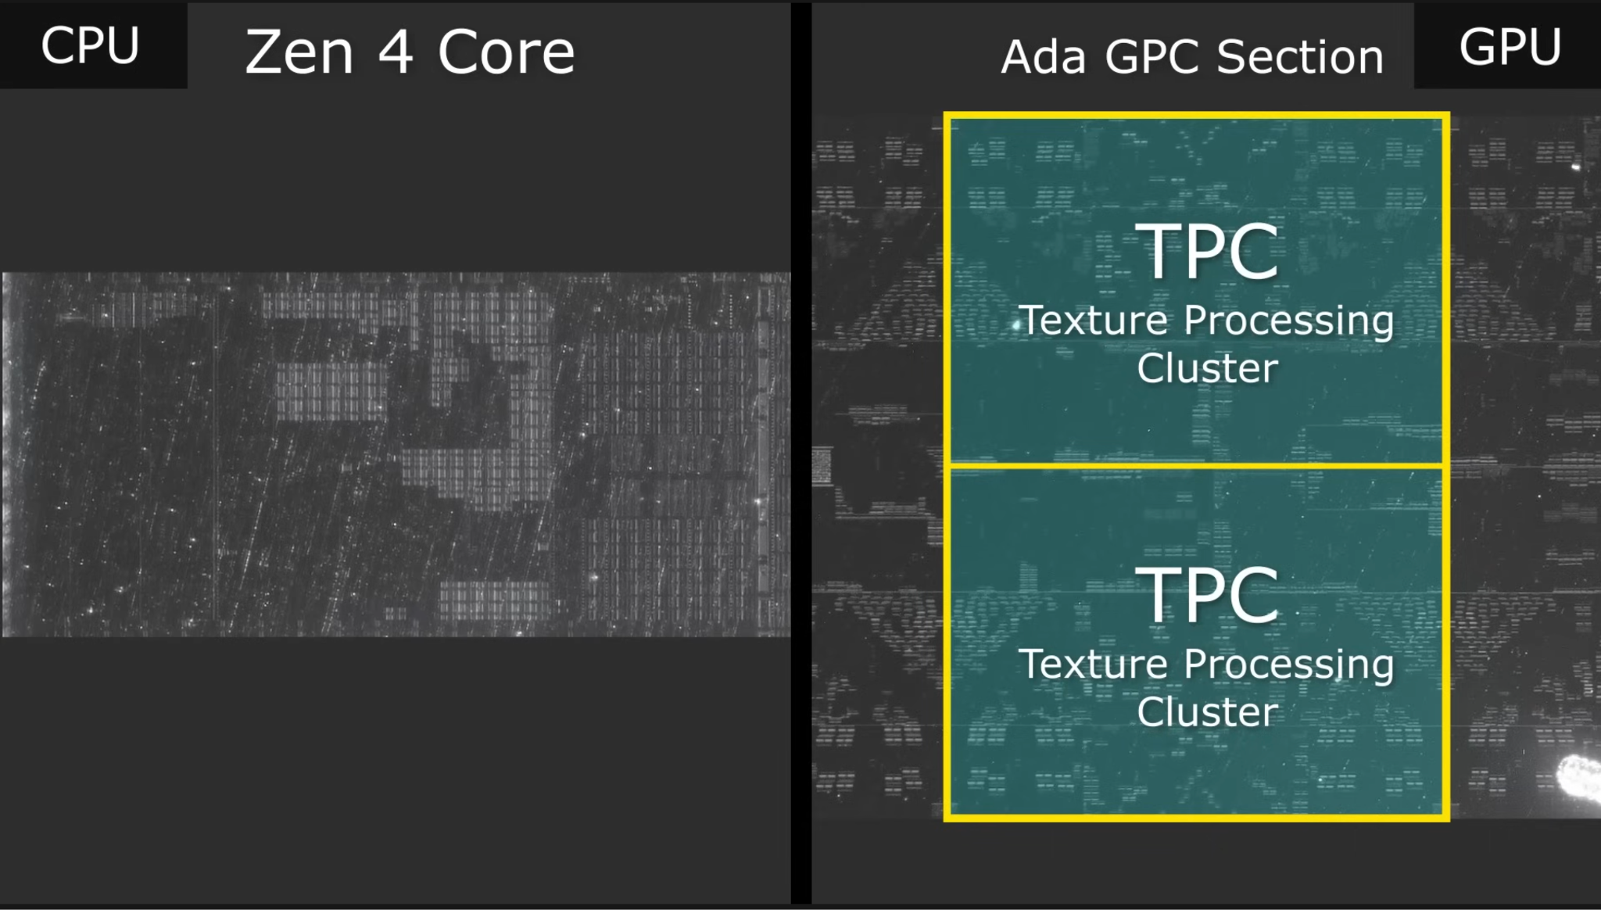

Slide 10
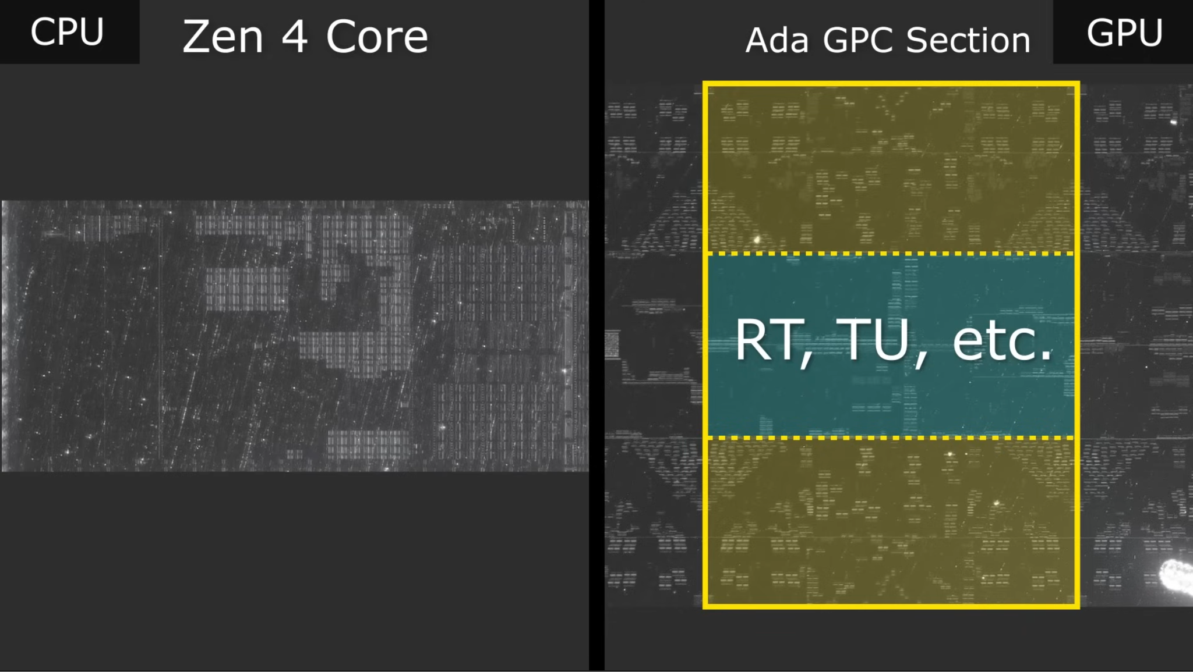

Slide 11
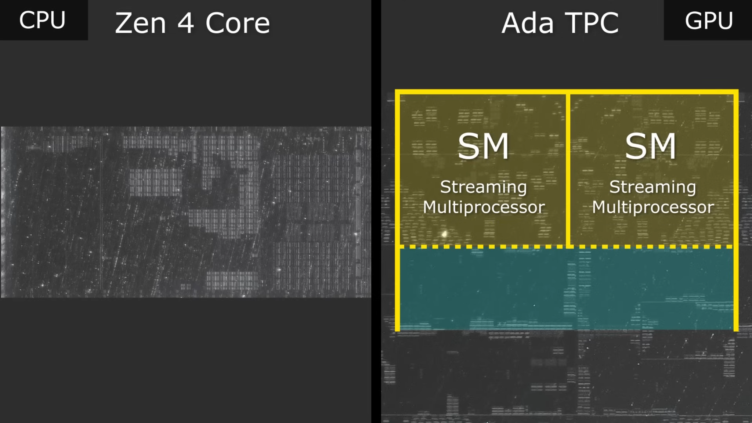

Slide 12
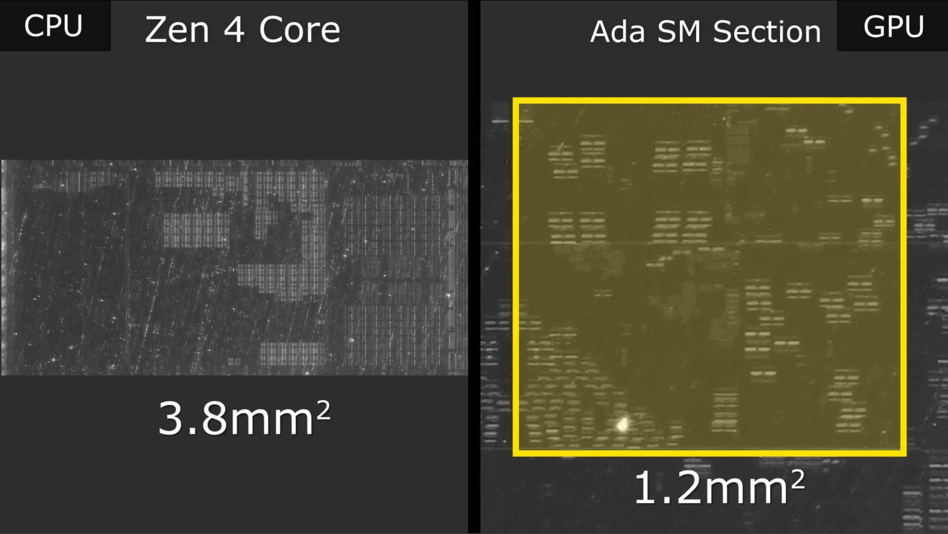

Slide 13
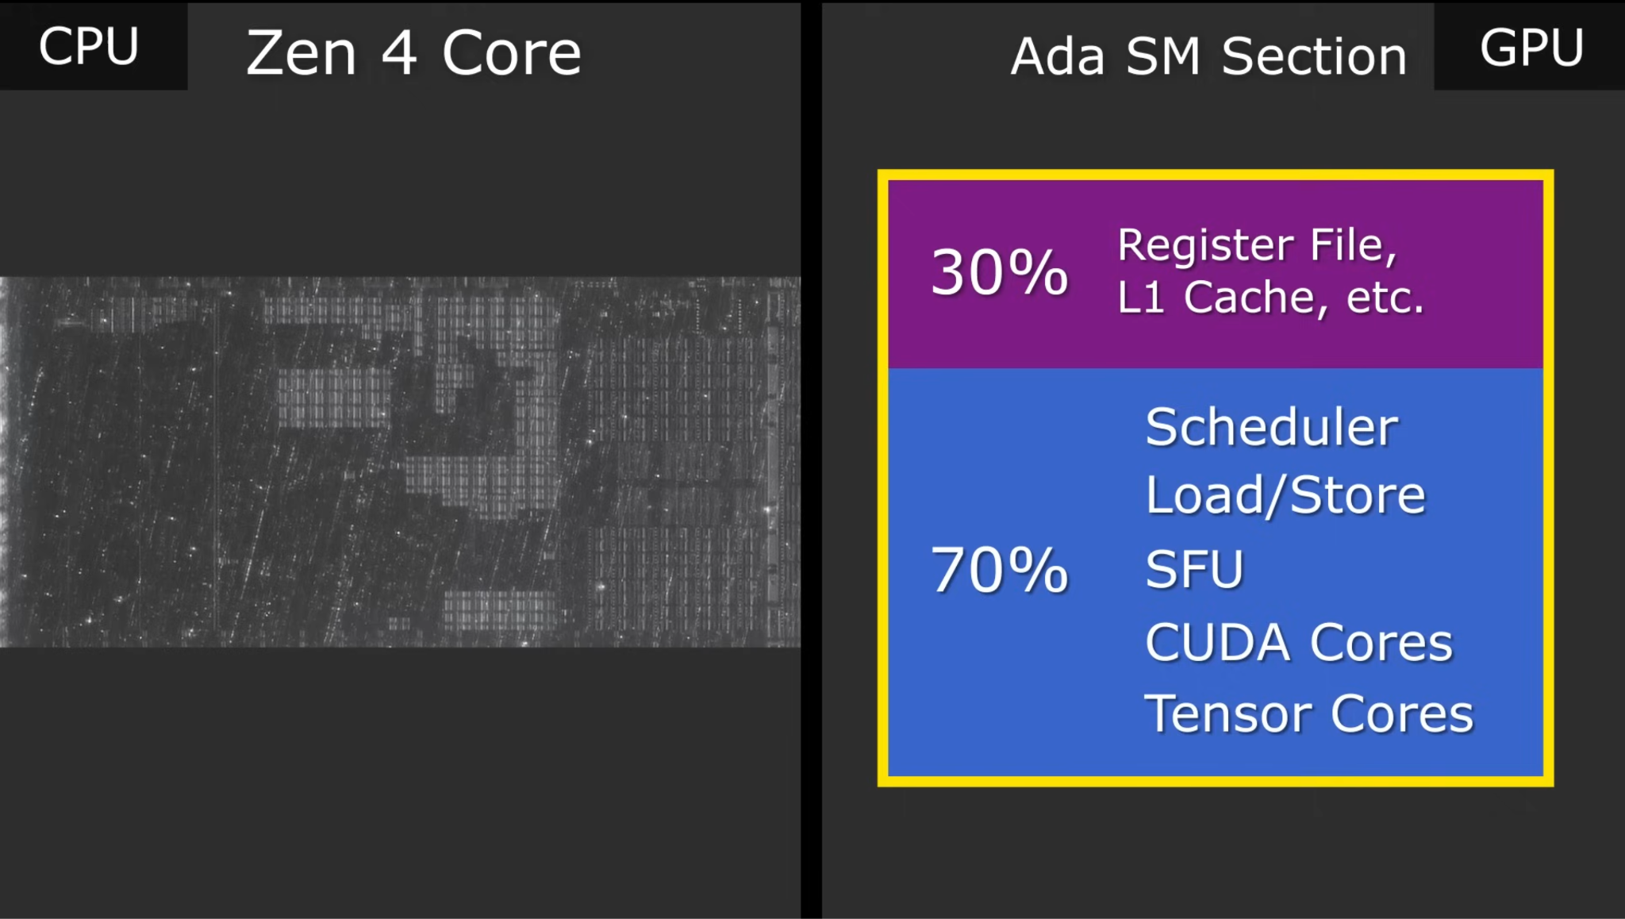

Slide 14
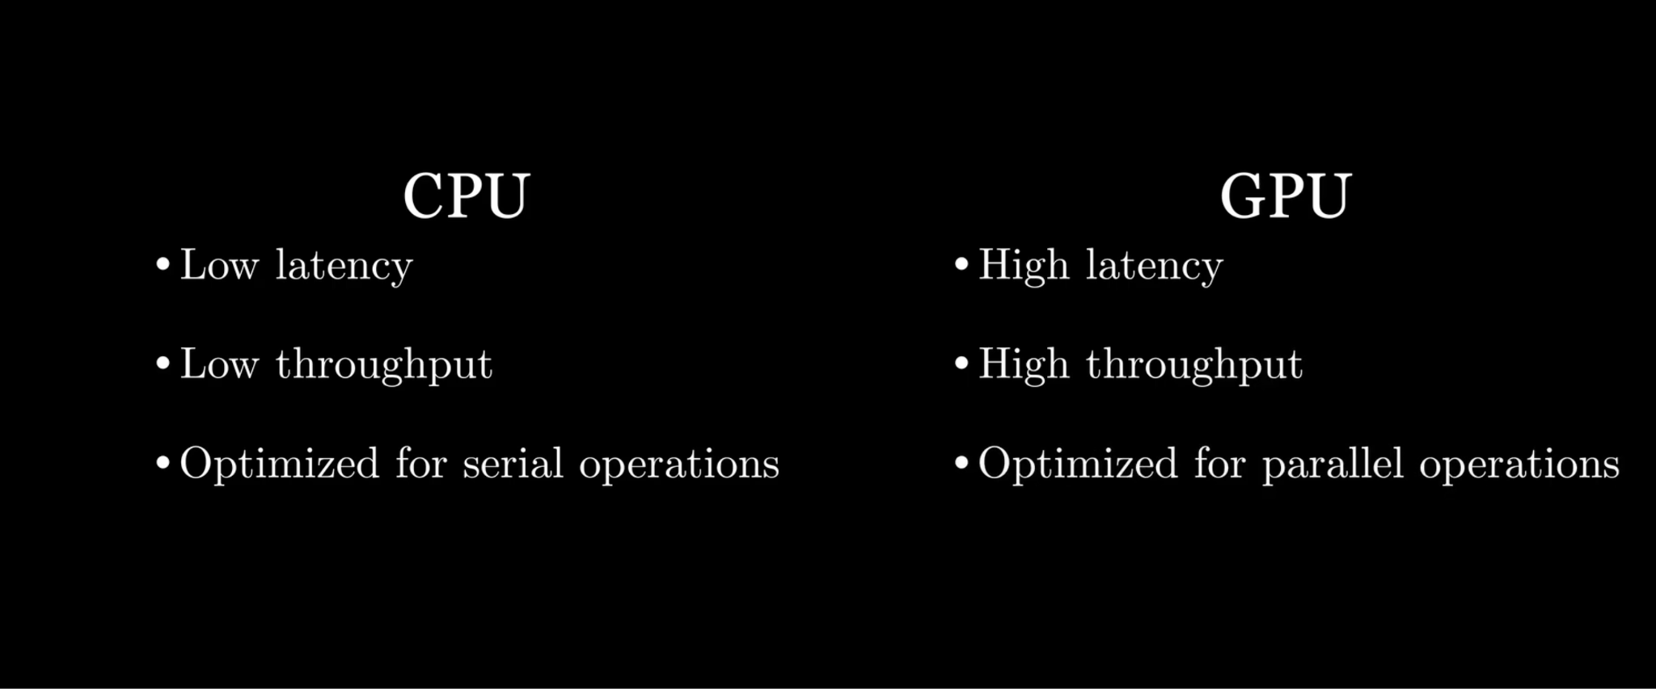

Slide 15
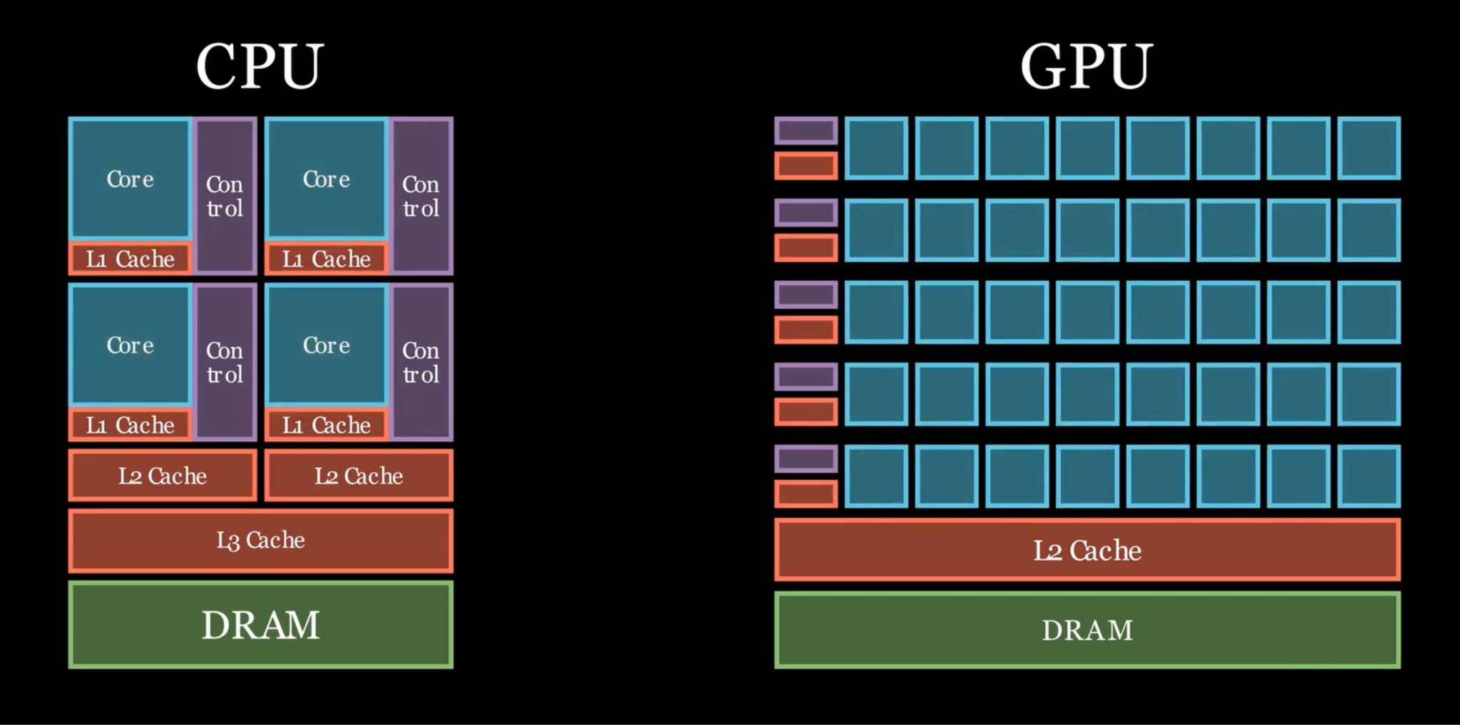

Slide 16
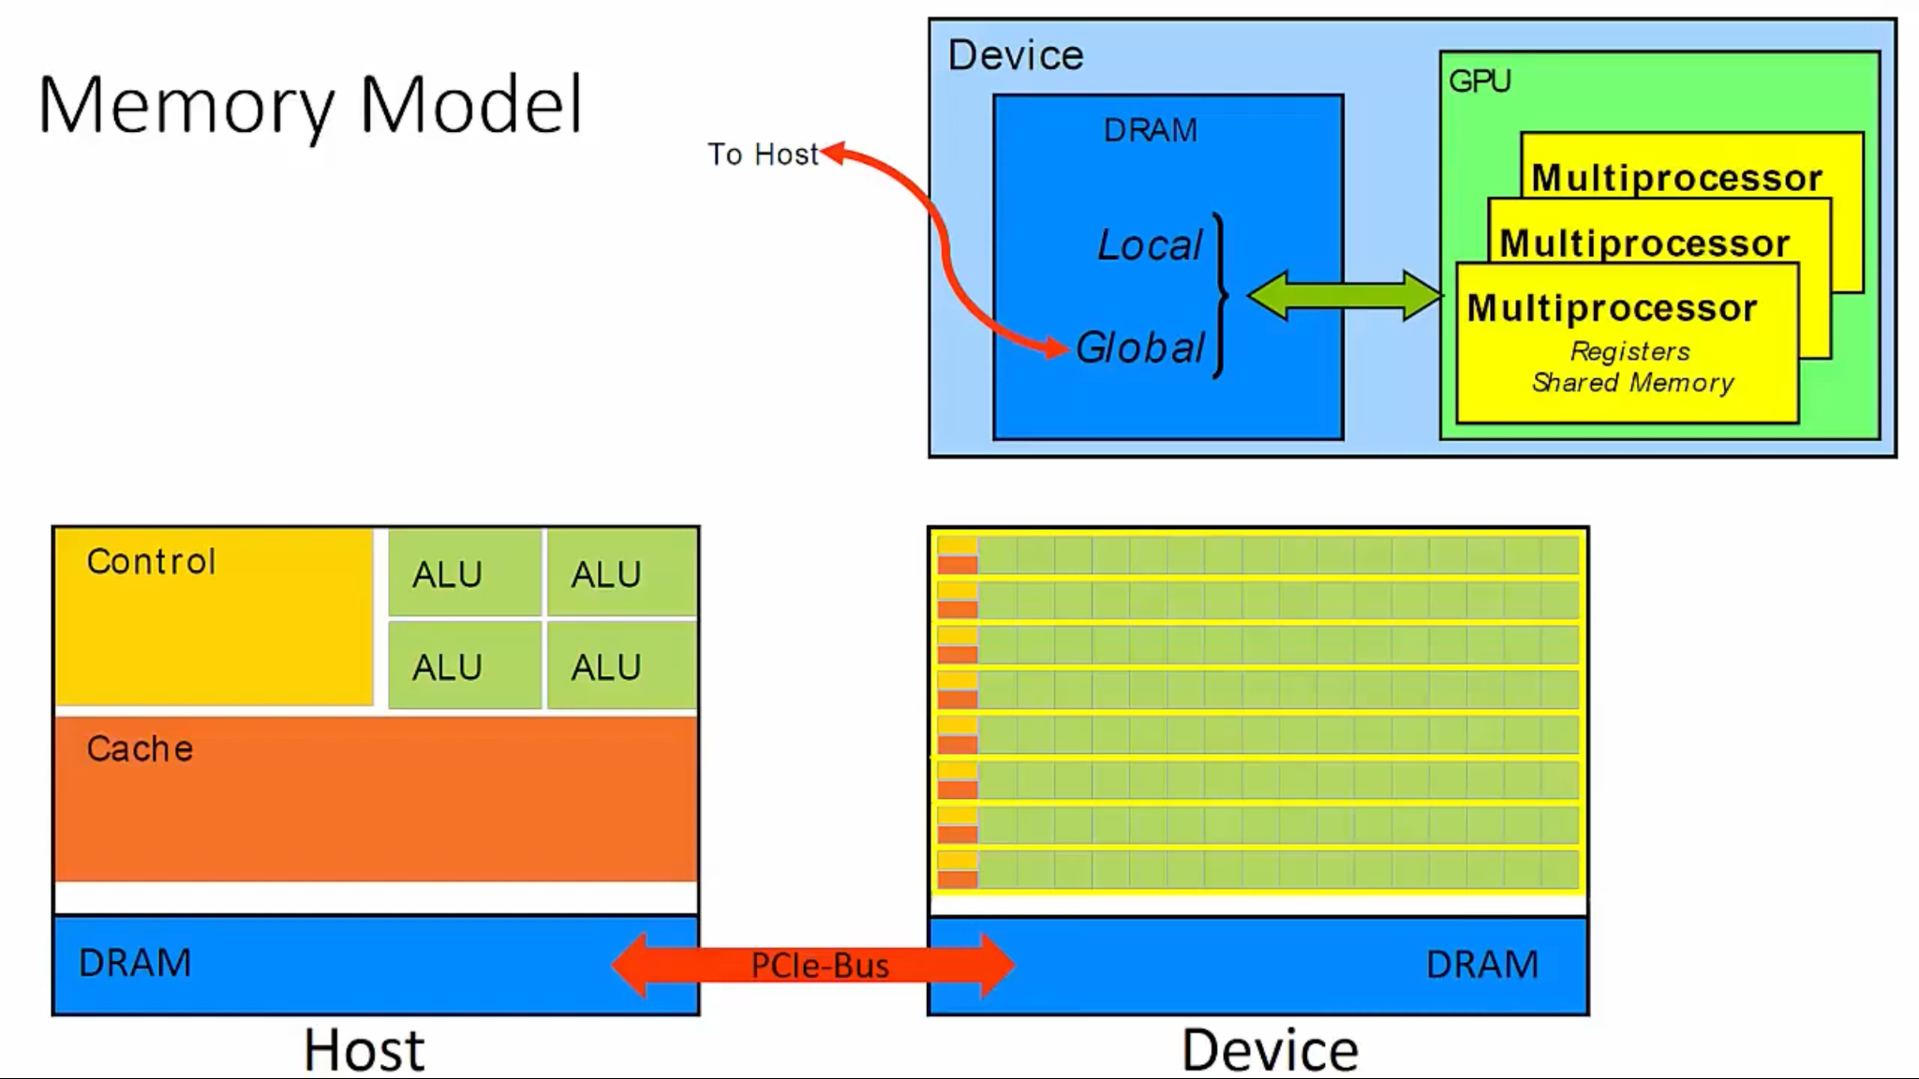

Slide 17
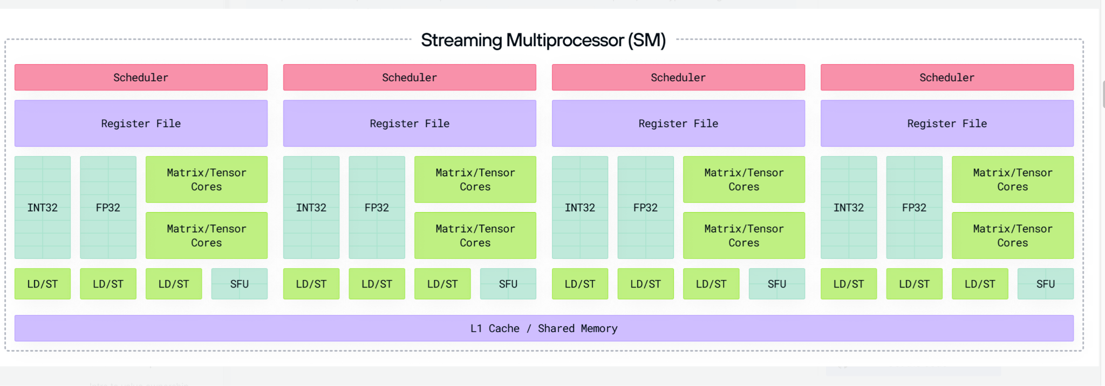

Slide 18
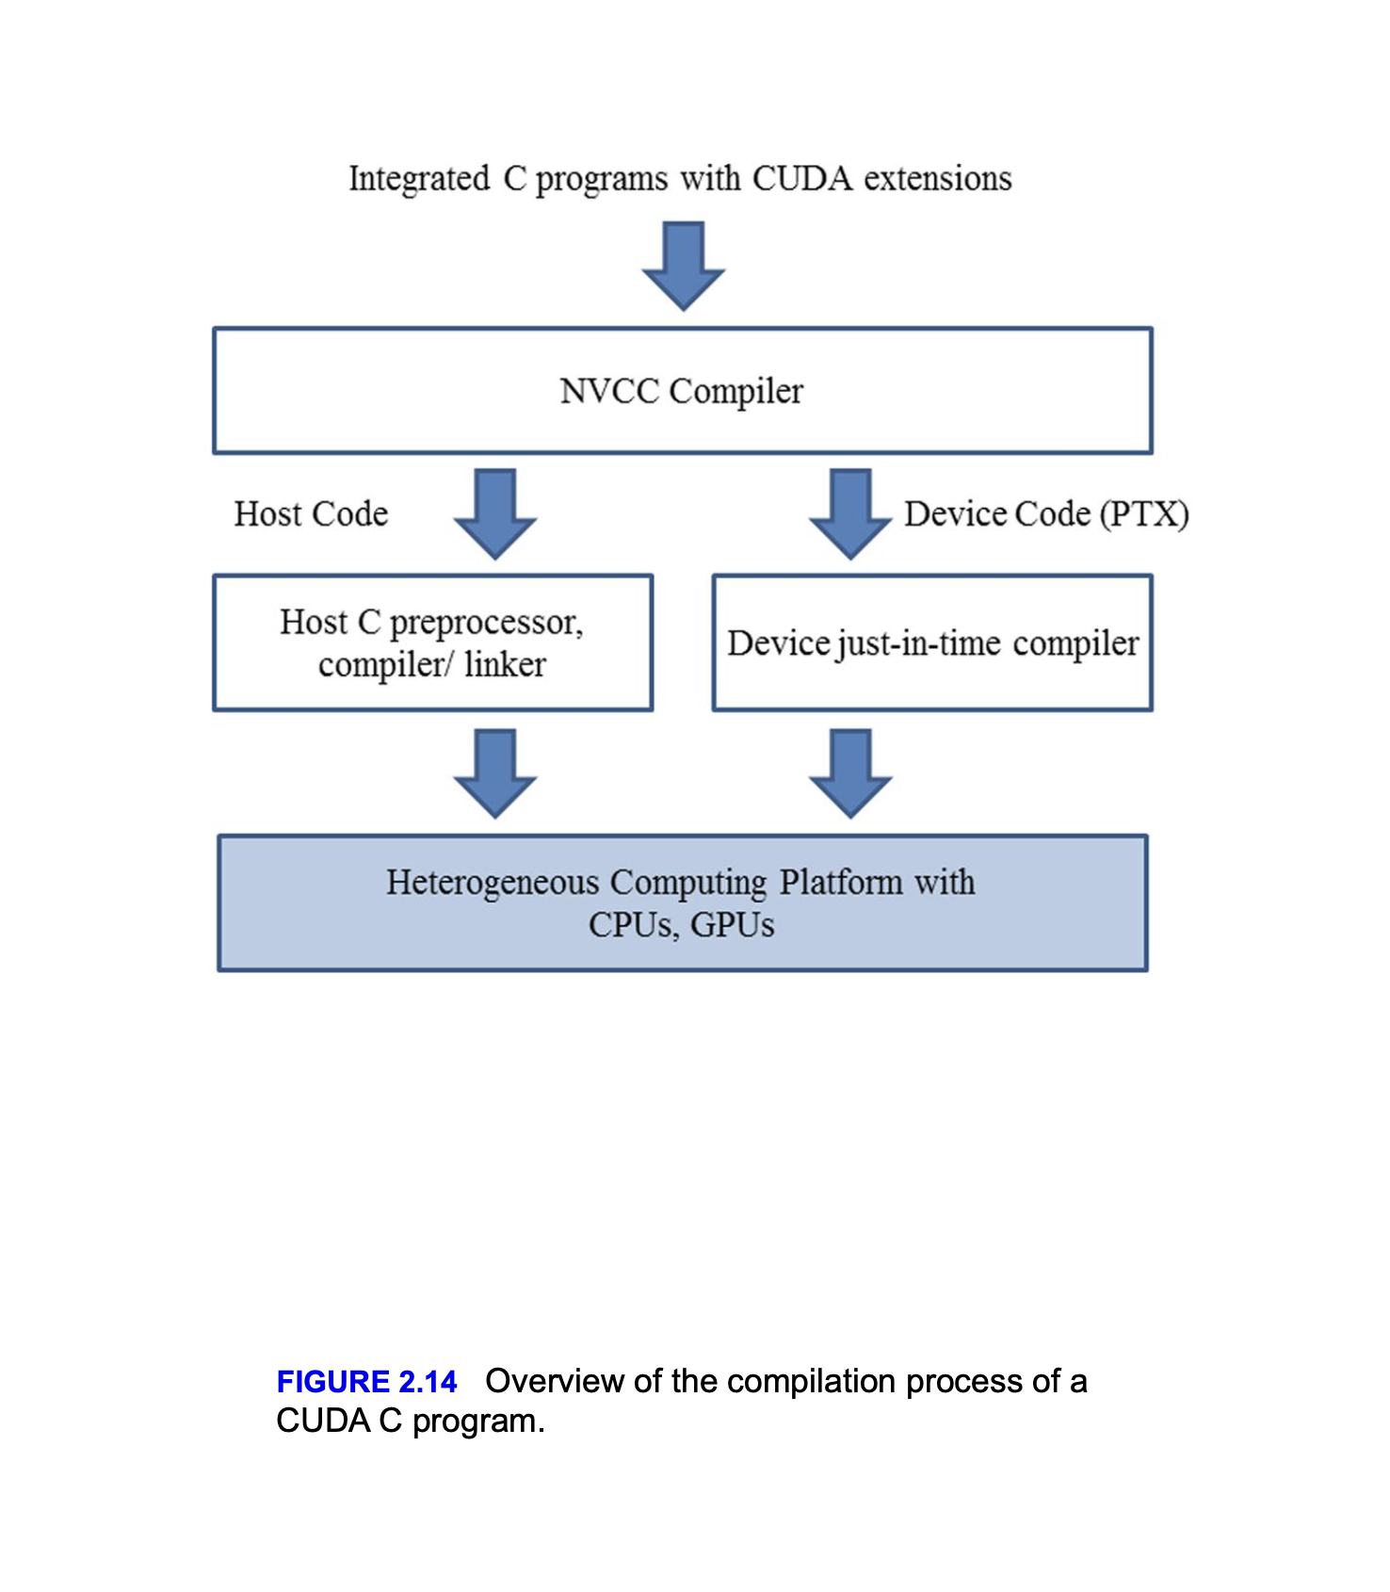
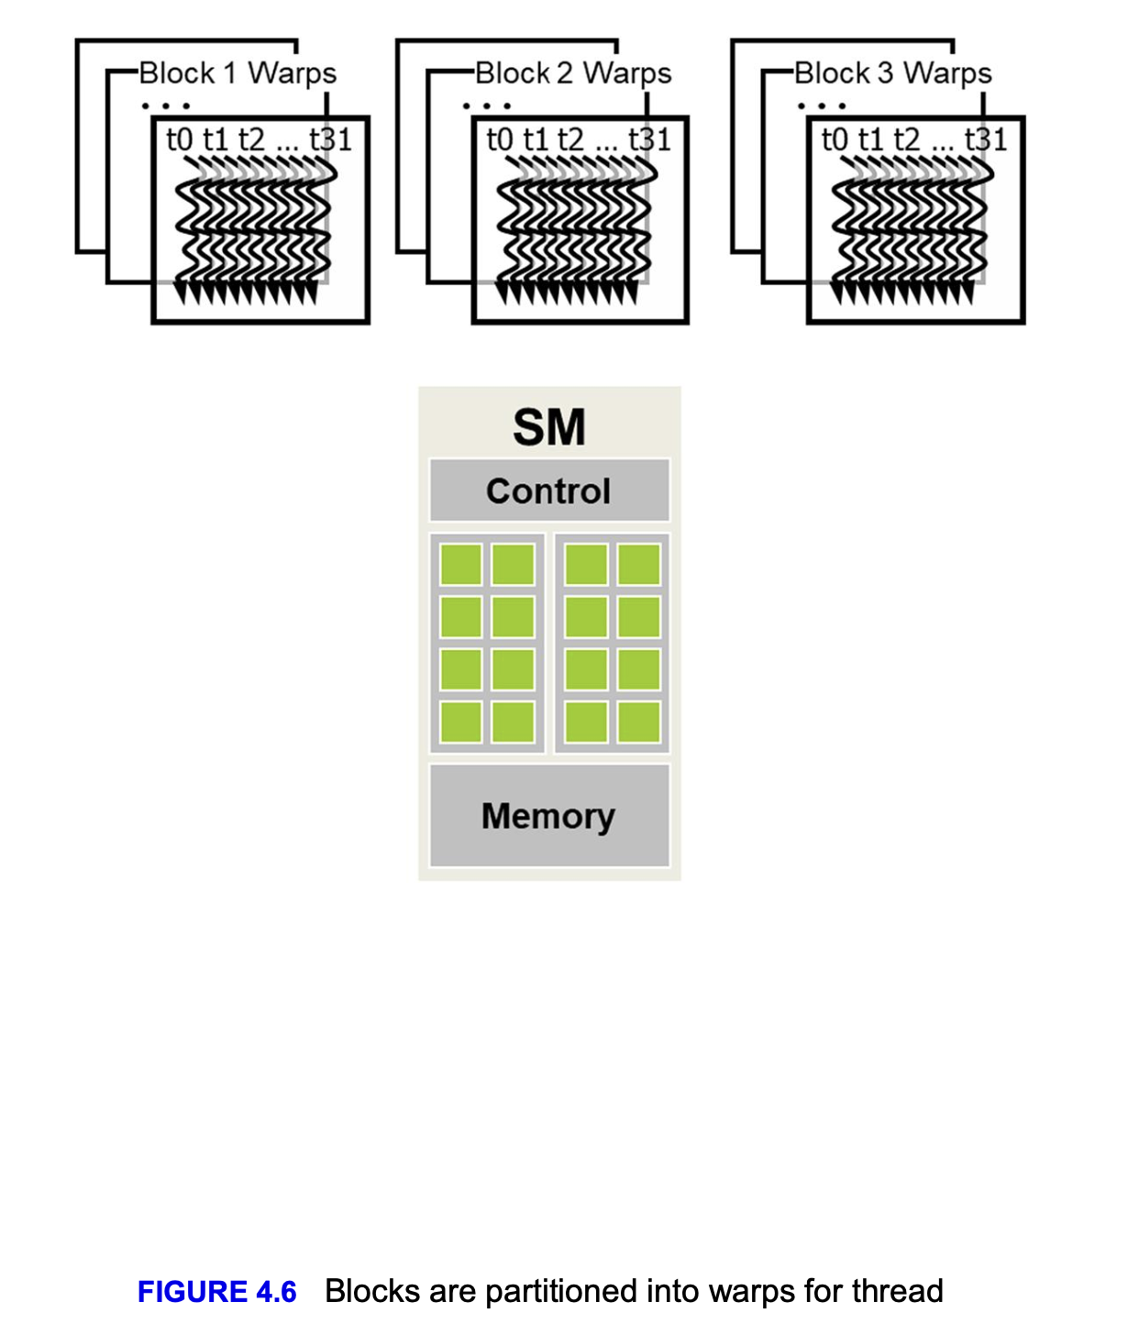

Slide 19
Checkpoint 1
Now let's write our first cuda program and see the power of the cuda debugger
Google collab -> https://colab.research.google.com/drive/1PtM1Jz87-Ht4RlSZMxFkzSiSacqJInz-?usp=sharing
Or to go -> https://ozzyozbourne.github.io/gpumode/
And click on “First Cuda Program with CUDA-GDB”

Slide 20
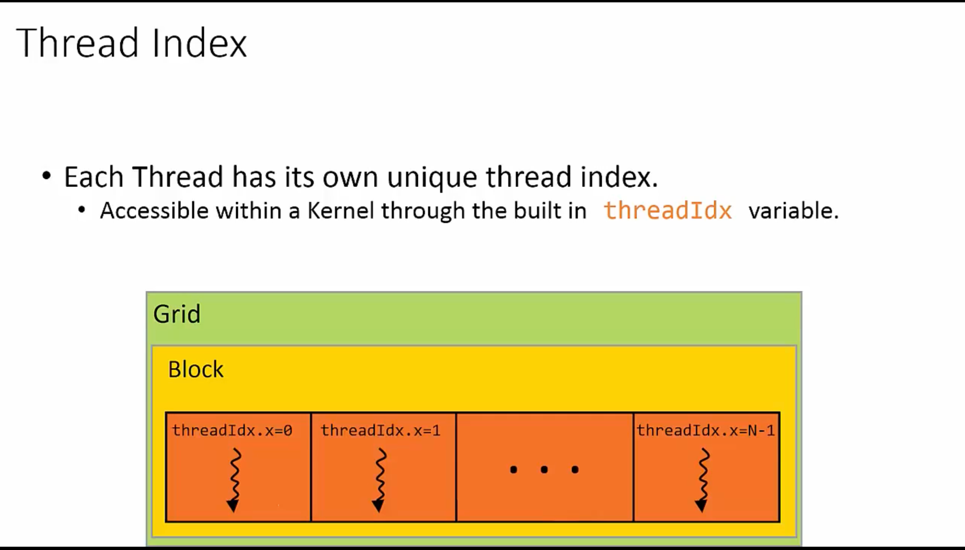

Slide 21
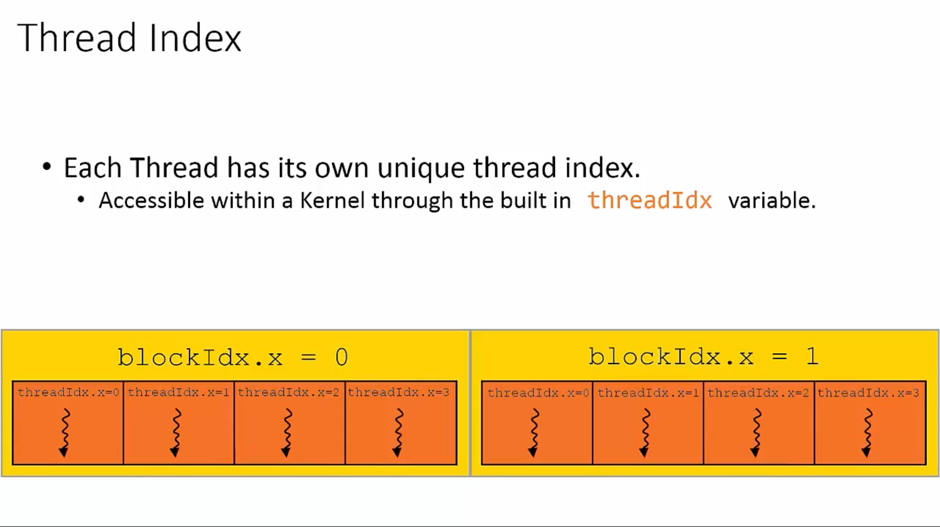

Slide 22
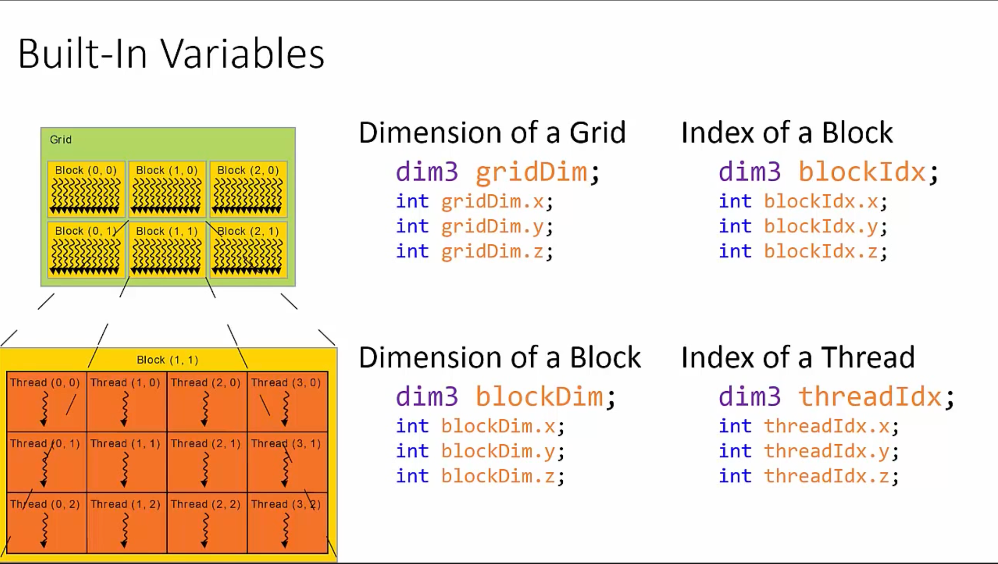

Slide 23
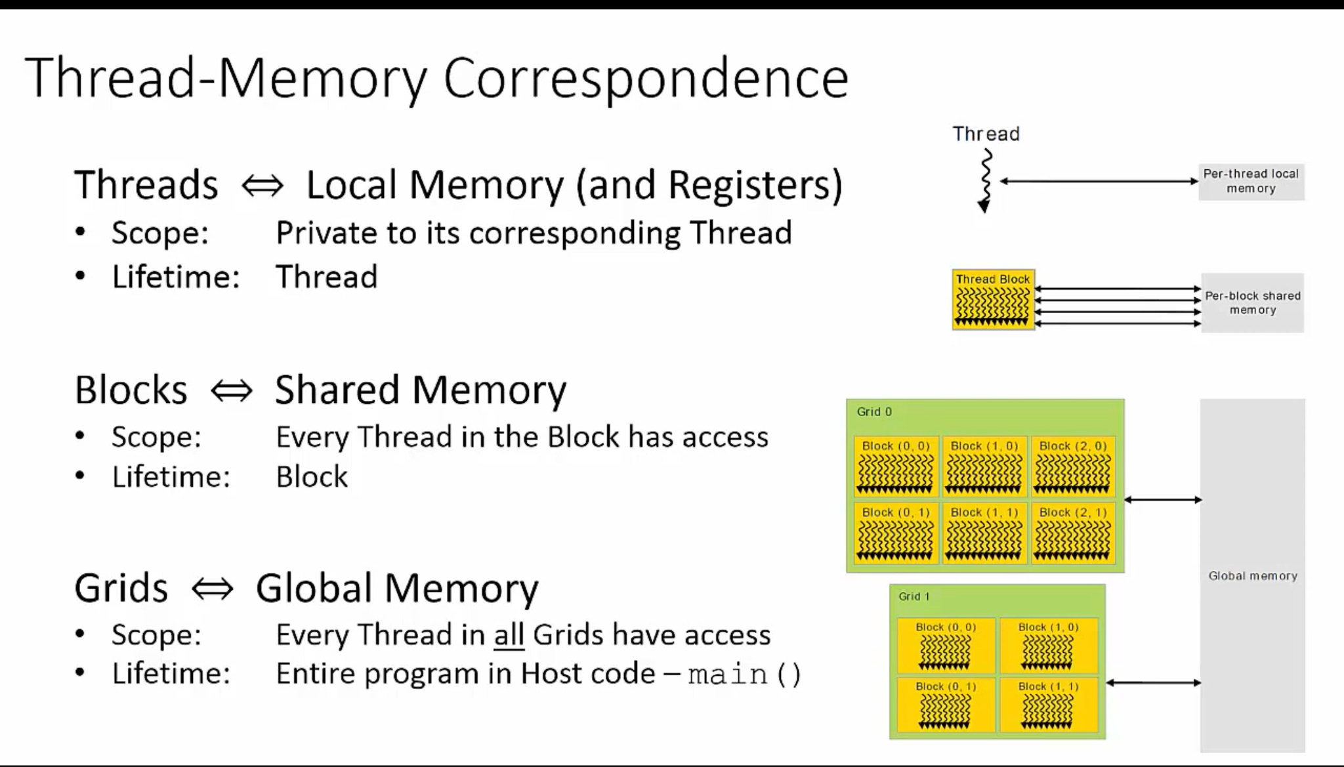

Slide 24
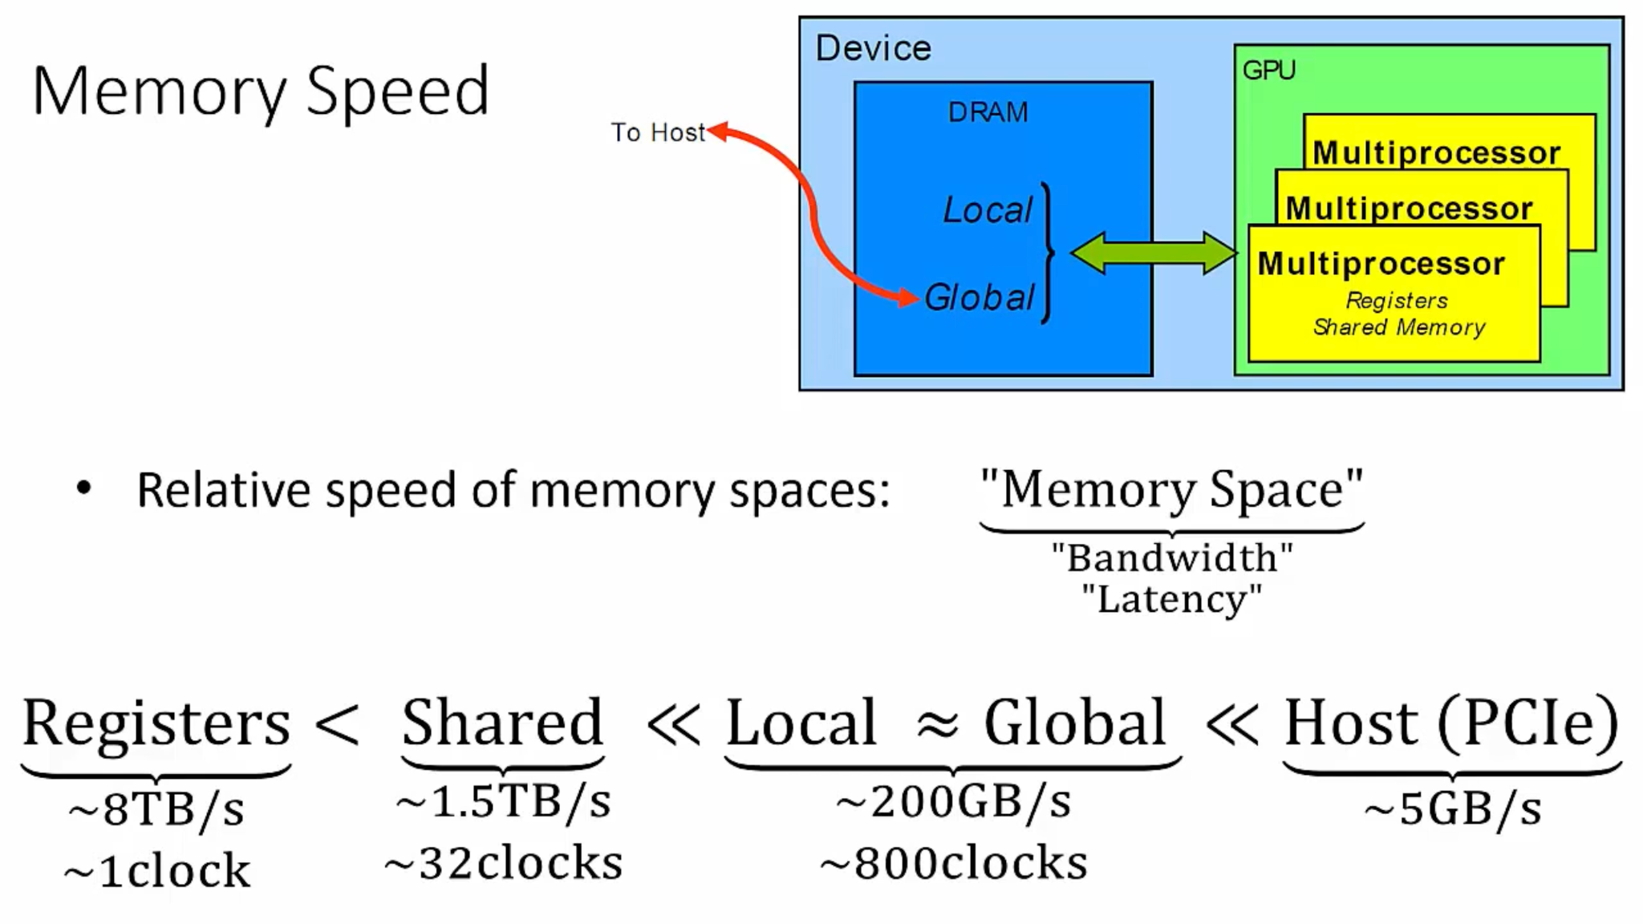

Slide 25
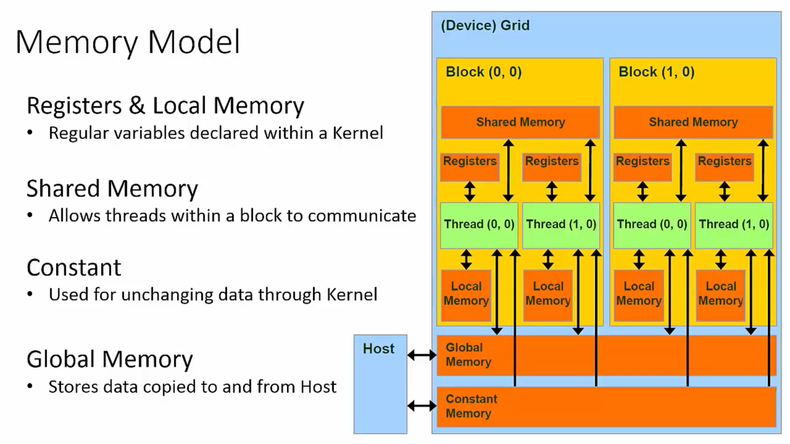

Slide 26
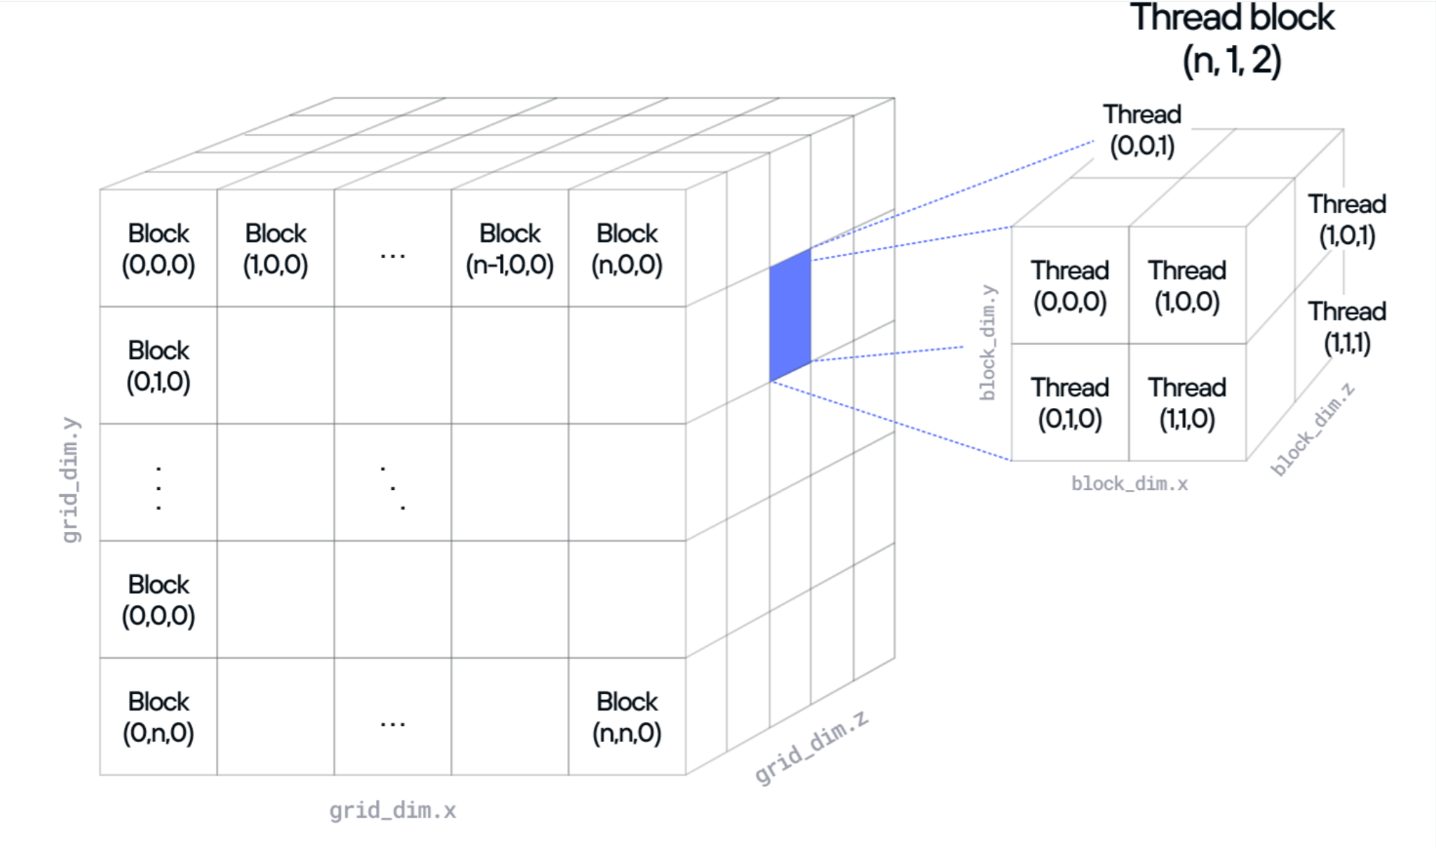

Slide 27
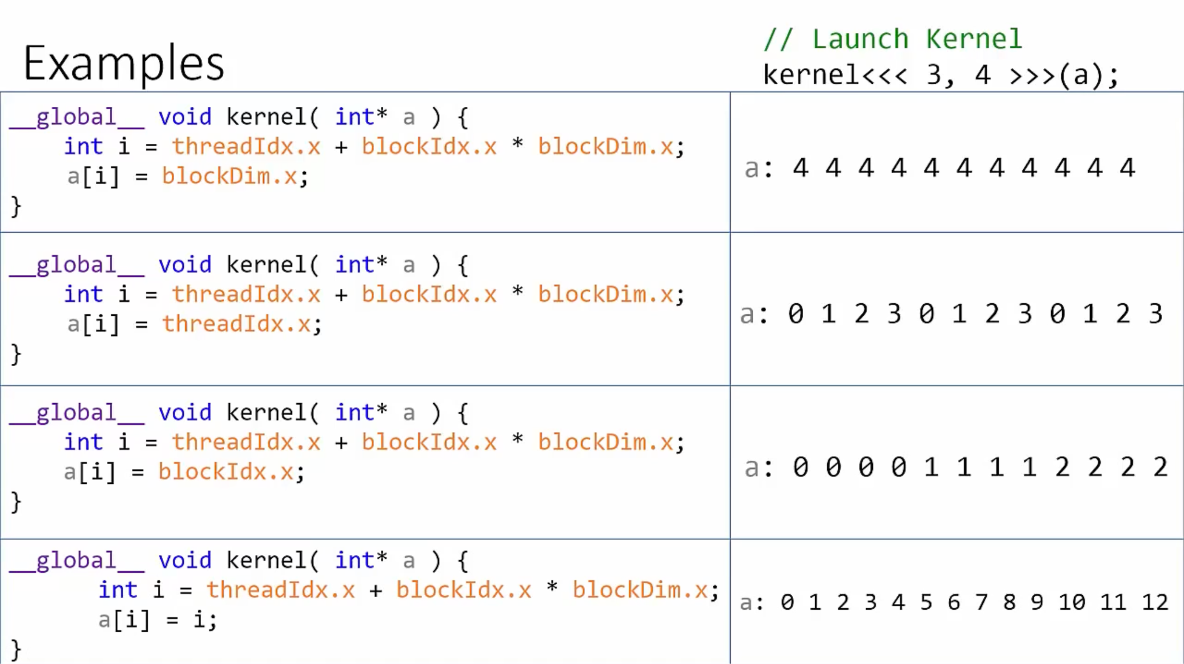

Slide 28
Checkpoint 2
Let's Play with thread Blocks and Dims
Google collab 5 -> https://colab.research.google.com/drive/1dXMtyFZcOuyFvdnTVycdr8fRdJIwt4mt?usp=sharing
Or to go -> https://ozzyozbourne.github.io/gpumode/ And click on “Cuda Thread Block Example”
Google collab 6 -> https://colab.research.google.com/drive/1RIDLMwNzs76vSxR6KLW6IgNF5rhD7Ogm?usp=sharing
Or to go -> https://ozzyozbourne.github.io/gpumode/ And click on “Memory Latency Hiding”
Profiling cuda kernel basic example
Google collab 7 -> https://colab.research.google.com/drive/1YbXhd9aLHkd2d87K9EpHVmV5Z-Y0MqzN?usp=sharing
Or to go -> https://ozzyozbourne.github.io/gpumode/ And click on “Basic Profiling”

Slide 29
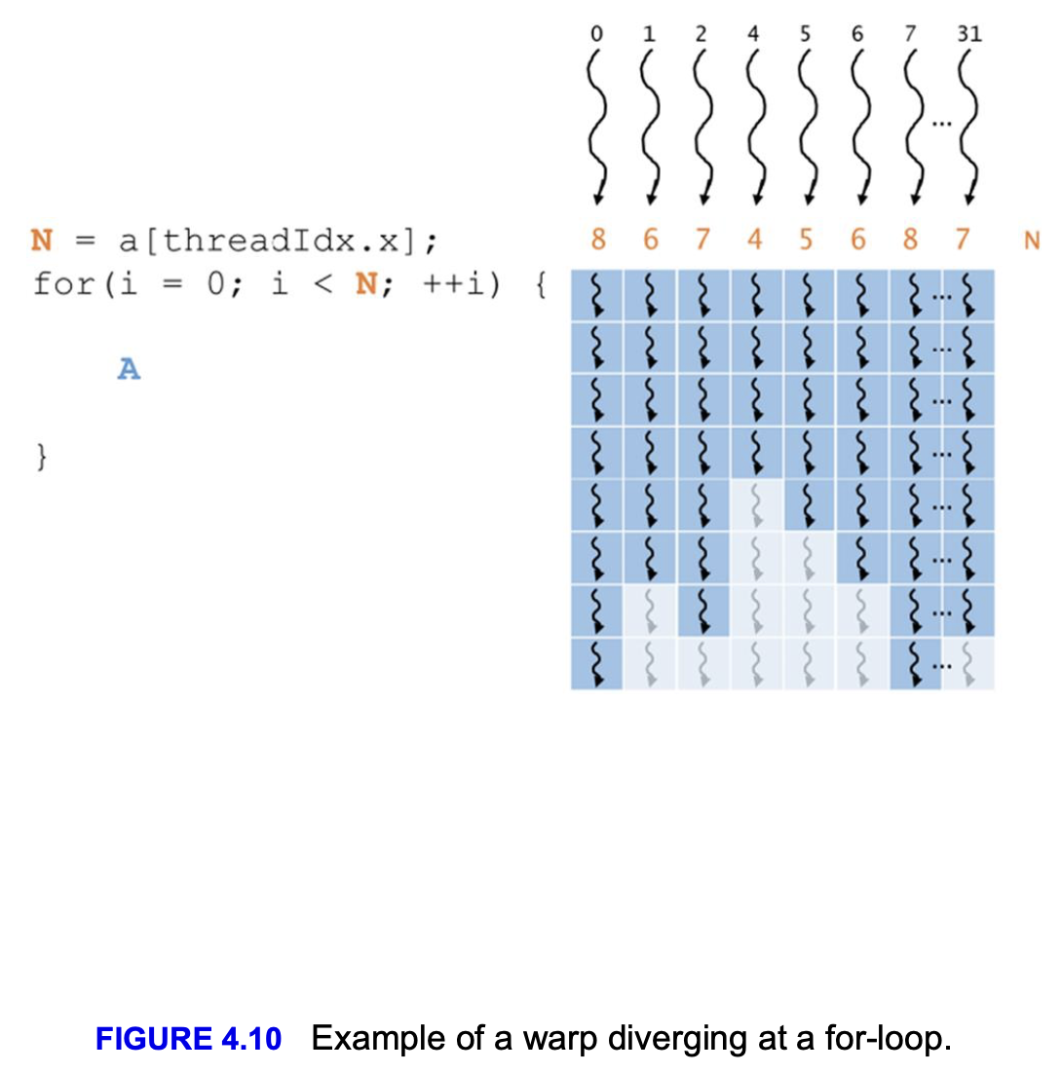
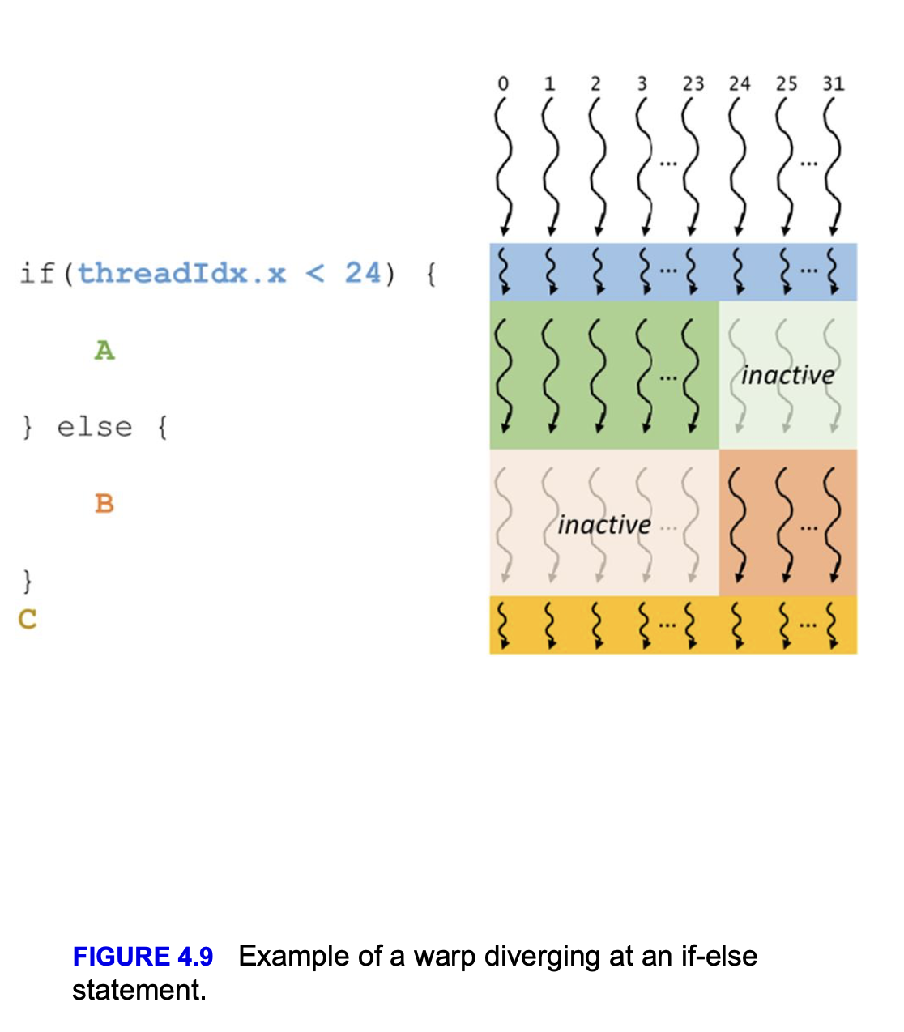

Slide 30
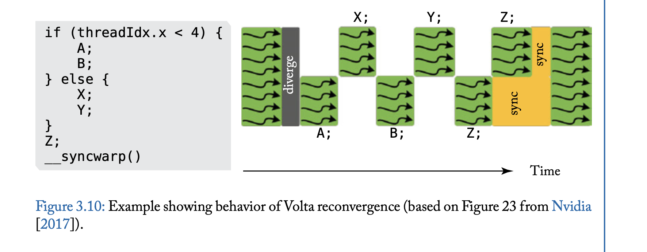

Slide 31
CheckPoint 3
Divergence!!
Google collab 8 -> https://colab.research.google.com/drive/1tjd5cXi1CN_BhBwUs5KkXCPtrxxws_FI?usp=sharing
Or to go -> https://ozzyozbourne.github.io/gpumode/ And click on “If_else_warp_divergence”
Google collab 9 -> https://colab.research.google.com/drive/1_AR_uKcw5XZcgRcwnogdhSP0MtTnjkCo?usp=sharing
Or to go -> https://ozzyozbourne.github.io/gpumode/ And click on “No Divergence”

Slide 32
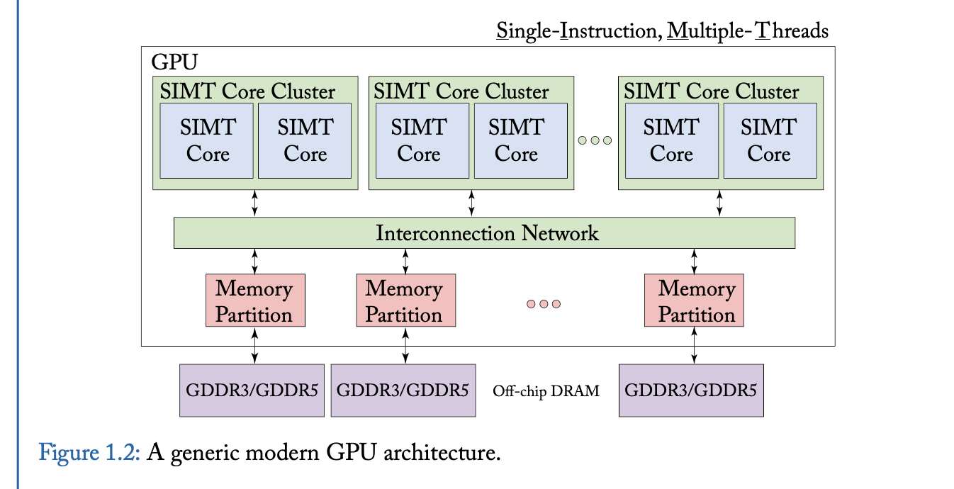

Slide 33
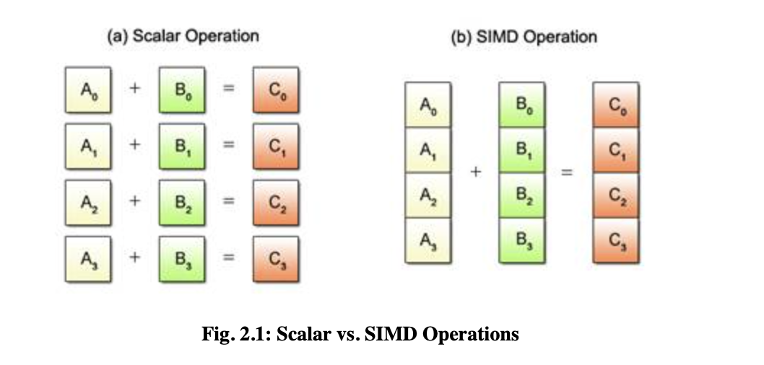

Slide 34
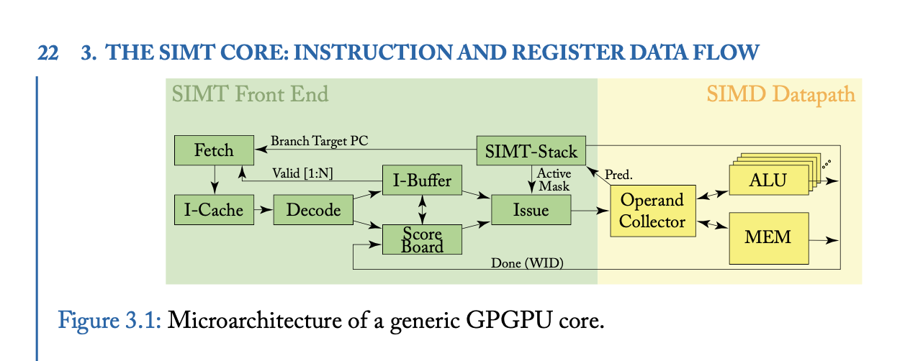

Slide 35
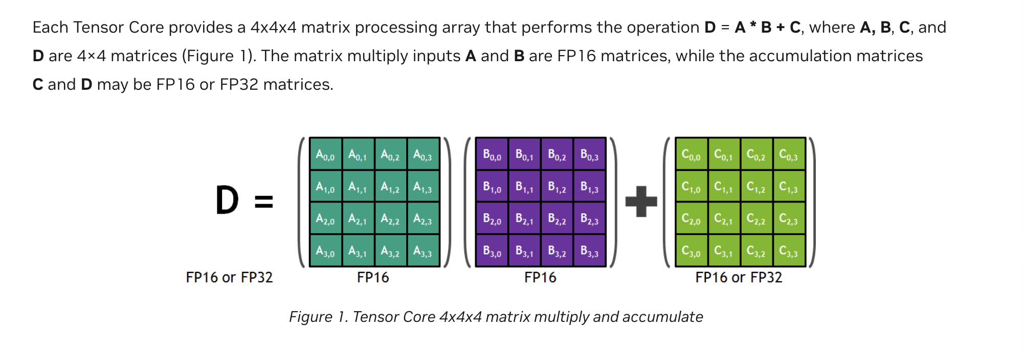
Tensor Cores

Slide 36
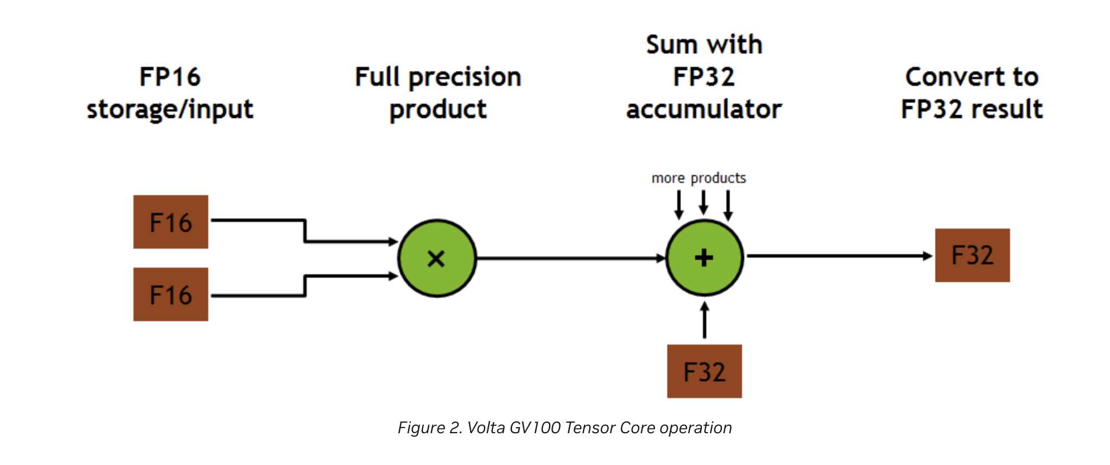

Slide 37
CheckPoint 4
SIMD OPS!!
Google collab 10 -> https://colab.research.google.com/drive/1CTnLvenNNApo8_YGFDxLI2GkT7kbIzXq?usp=sharing
Or to go -> https://ozzyozbourne.github.io/gpumode/ And click on “SIMD_ADD”
Google collab 11 -> https://colab.research.google.com/drive/1asInCeeGDcQV4q-3r9MbY9vb3NYfFlyH?usp=sharing
Or to go -> https://ozzyozbourne.github.io/gpumode/ And click on “SIMD DIVERGENCE”
Google collab 12 -> https://colab.research.google.com/drive/1pIm8usKsaxae-NCsHdd4en9hYgkSqkus?usp=sharing
Or to go -> https://ozzyozbourne.github.io/gpumode/ And click on “SIMD FMA”

Slide 38
Thank you for attending
Let's make GPUs go brrr!

